Slide 1
CSCE 431 Golden Rules
10/6 – Submit to get Attendance Credit

Slide 2
Golden Rules - Design Principles
Place the user in control
Reduce the user’s memory load
Make the interface consistent
Make your interface accessible
SEE NOTES AT THE END OF THE SLIDE DECK AFTER “GOLDEN RULES EXPLAINED”

Slide 3
1.) What Went Wrong?

Slide 4
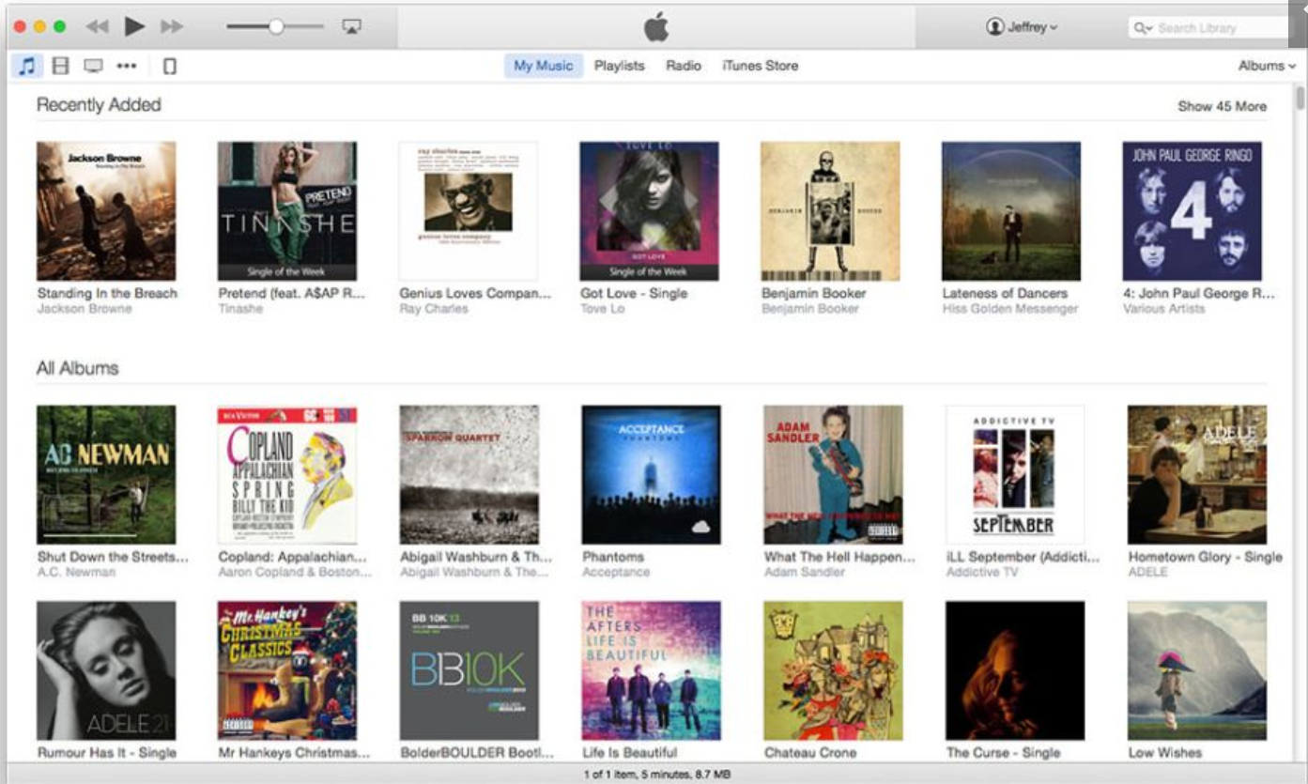
What’s wrong?
Golden Rules - Design Principles
Place the user in control
Interface is not easy-to-navigate. There are no visual cues to know whether something is a single or an album. Ex. Recently Added is a mix of albums and singles.
No accommodation for users with different skill levels. No option to filter for specific music. Interface is easy-to use, but too simple; no advanced options.
Reduce the user’s memory load
Visual layout is not synonymous to a music library, more like a vinyl library. This is not ideal and easy to use for a user, it takes up a lot of screen space.
Shortcuts to add a song/play a song are not shown by default.
Albums are emphasized more than the song title which is unintuitive.
Make the interface consistent
Make your interface accessible
It is easy to click on the album/single covers, however the indicators to "show more" and to change from "albums" to "singles" is very small, and may be hard to navigate for certain people who accessibility issues
There are no indicators to help people know what to do with these album/single covers.
Notes:
1.) What golden rule(s) does this design violate?
2.) For each golden rule violated, explain why?

Slide 5
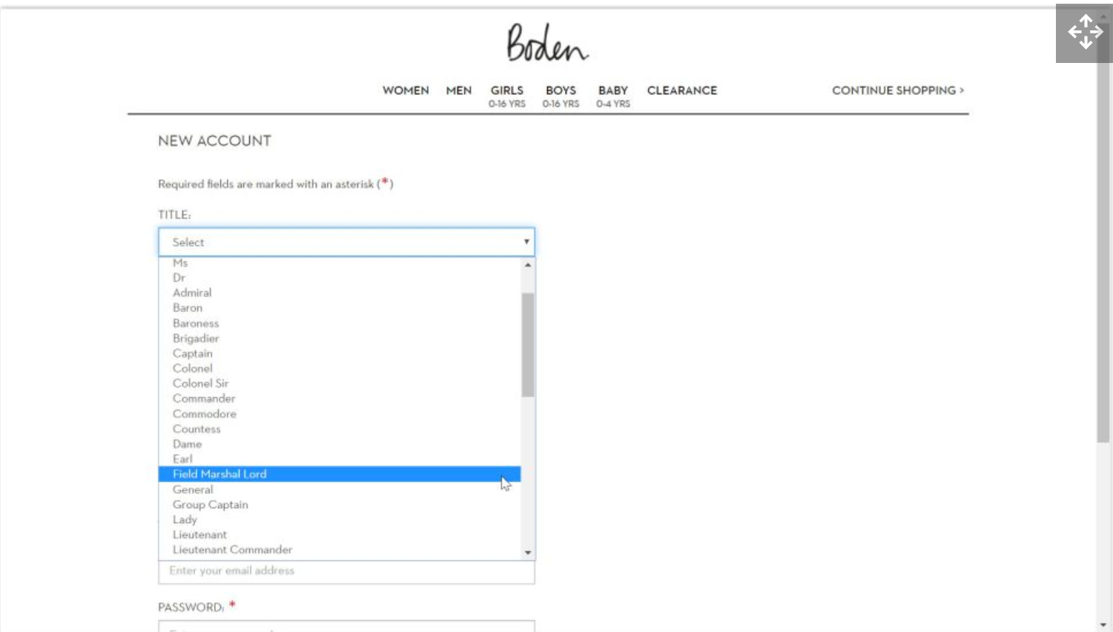
What’s wrong?
Golden Rules - Design Principles
Place the user in control
It looks like the user cannot easily get out of the drop down unless they manually click out of it. No visible shortcut for this.
Has overlap with email address field
Reduce the user’s memory load
So many different options for the titles. Instead, this should be a text field.
Make the interface consistent
There is no floating buttons whatsoever in this page. A good one for this could be a "Contact Support" icon on the bottom right in the screen for the user to chat with support if in need.
Make your interface accessible
There is no Accessibility button on this page. This goes hand in hand with making the interface consistent. For example, having a floating button somewhere on the screen for the user to easily change this.
The name of the store is hard to read for people with disabilities such as dyslexia.
Font style looks ok.
The font size could be bigger for people to see.
Having some of the fields side by side could be useful instead of having them in a single column.
Notes:
1.) What golden rule(s) does this design violate?
2.) For each golden rule violated, explain why?

Slide 6

What’s wrong?
Golden Rules - Design Principles
Place the user in control
Reduce the user’s memory load
Make the interface consistent
UI is all over the place. Click and hold button is vastly different compared to other toggles and buttons. Sandwich button is hard to see and decipher. No consistency in design.
Make your interface accessible
Buttons and areas to click are hard to reach. Hard to see visually; not clear. Visually impaired person would have trouble using this UI.
https://www.ifly50.com/en_us/50
Notes:
1.) What golden rule(s) does this design violate?
2.) For each golden rule violated, explain why?

Slide 7
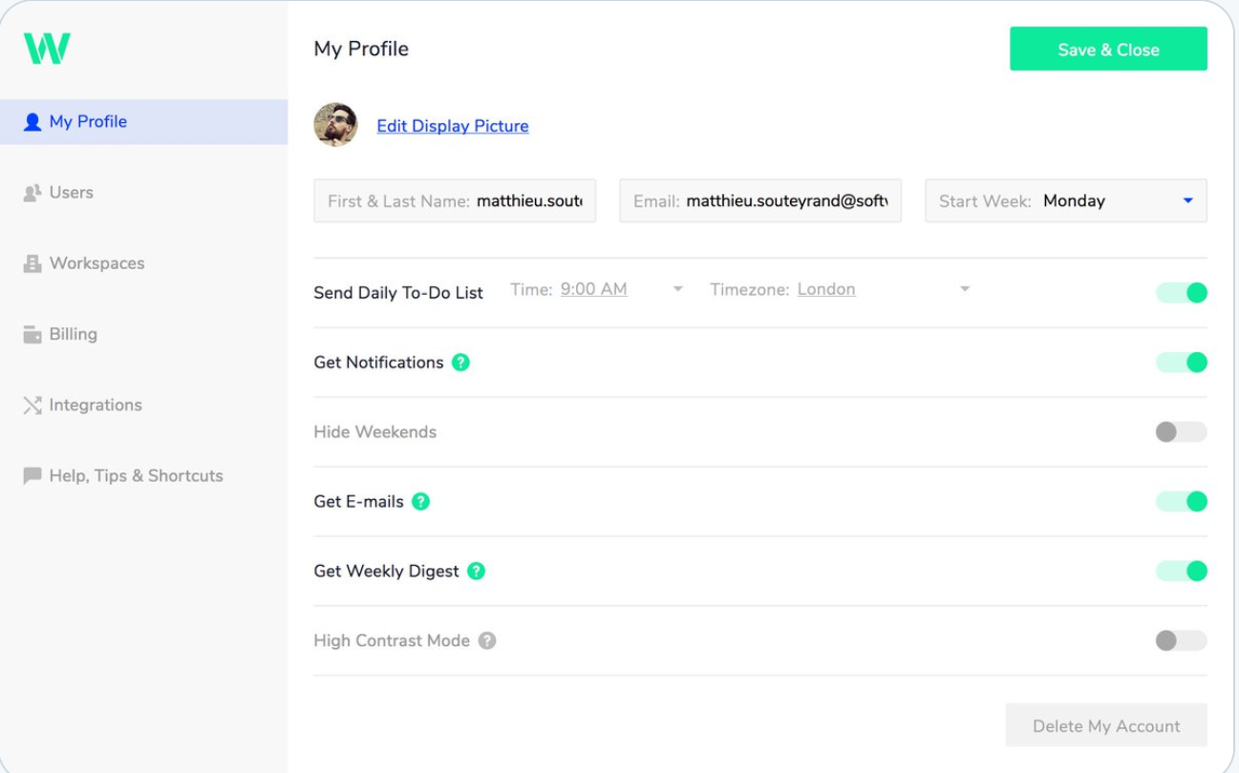
What’s wrong?
Golden Rules - Design Principles
Place the user in control
Reduce the user’s memory load
Make the interface consistent
Make your interface accessible
Nothing wrong here. Website is accessible and has options for high contrast mode for accessibility. The user is in control of options within their profile. They can save and close. The interface is consistent. Contextual information is provided for each option, reduces the memory load to the essentials. Great UI design overall.
Notes:
1.) What golden rule(s) does this design violate?
2.) For each golden rule violated, explain why?

Slide 8
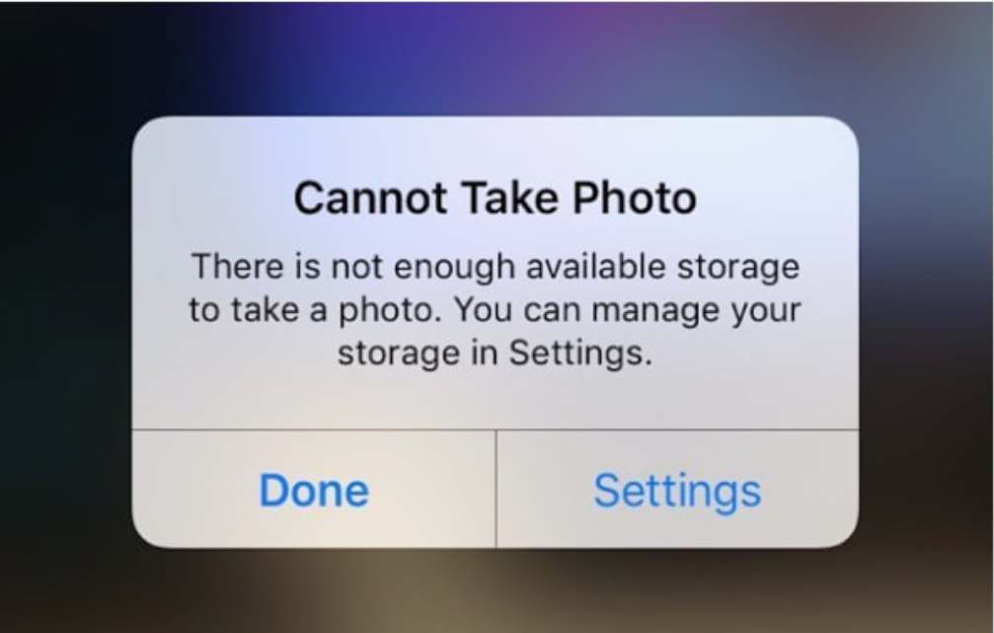
What’s wrong?
Golden Rules - Design Principles
Place the user in control
Reduce the user’s memory load
Make the interface consistent
Make your interface accessible
Nothing wrong here. The user is in control, they are able make their actions reversible, or go to the direct place needed to resolve the issue. Error is perfect to ensure that too much information is stored in storage.
Notes:
1.) What golden rule(s) does this design violate?
2.) For each golden rule violated, explain why?

Slide 9
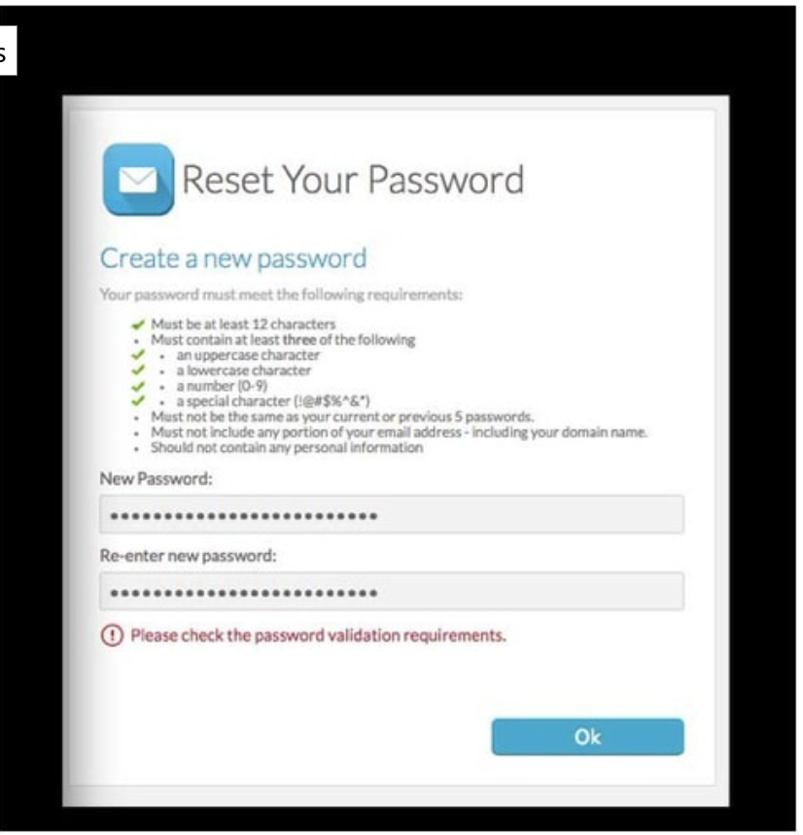
What’s wrong?
Golden Rules - Design Principles
Place the user in control
Reduce the user’s memory load
User is overloaded with information regarding password requirements
It is unclear what is wrong with the password.
Make the interface consistent
Mail icon is useless, provides no value to the design for "reset my password" form.
Make your interface accessible
Notes:
1.) What golden rule(s) does this design violate?
2.) For each golden rule violated, explain why?

Slide 10

What’s wrong?
Golden Rules - Design Principles
Place the user in control
This is not putting the user in control, since there is no way for the user to change the rating
Reduce the user’s memory load
Make the interface consistent
Make your interface accessible
This is not accessible as there is no clear way to rate it or do anything with this icon
Notes:
1.) What golden rule(s) does this design violate?
2.) For each golden rule violated, explain why?

Slide 11
2.) Reflection

Slide 12
Reflect on how you violated any of the Golden Rules and what you will do to improve it in Sprint 3.
Put your reflection here. The more specific the higher your grade will be.
A big rule that we violated was Make Your Interface Accessible.
Our login system only has certain hyperlinks for forgetting a password or logging in with Google OAuth. This makes it hard for someone who is visually impaired to determine the right option depending on their satiation. We plan on improving it in Sprint 3 by implementing clear, distinct buttons. (Actual google logo for OAuth.
Make the interface consistent
Some of our pages have bootstrap and some of them don't, so the look is not consistent on all pages. We plan on fixing this in sprint 3 by fully implementing our UI, since we saved it for the last sprint.
Another big rule we violated was Place the user in Control.
Currently, we don't have ways for members to edit data or use the website in a meaningful way yet.
Going forward, we need to not only make sure that the functionality exists, but that the user can easily determine what they can and can't edit, and allow them to do so easily with clear instructions when required.

Slide 13
3.) Peer Review

Slide 14
List the contribution of each person below
Thierry David: Contributed to the first 3 slides of "What's wrong". Helped discuss and added information on what we violated in terms of Golden Rules for our first and second sprint (so far).
Frank Martinez: Contributed to the 2nd, 4th, and 5th of "what's wrong". Discussed with team while in the same room.
Dillon Lee: Contributed to the 10th slide of what's wrong, as well as the Reflection. Helped discuss the best movies of the century.
Mualla Argin: Contributed to the reflection slide (12) and the What's Wrong slides (3,4,5)
Macy Drew: Discussed various UIs' pros and cons, proofread slides.
Nathan Patterson: Reviewed apps for flaws, discussed slides.

Slide 15
GOLDEN RULES EXPLAINED

Slide 16
Place the User in Control
Allow user interaction to be interruptible (without losing work)
Example, if user enters “search” mode, should be able to exit with minimal effort
Ctrl C
Flexible interaction.
Example, allow user to interact via keyboard, mouse, etc.
Make actions reversible (explore the product without fear of failure)
Example: undo-redo
Notes:
Define interaction modes in a way that does not force a user into unnecessary or undesired actions.
Make actions reversible – be forgiving
This rule means that the user should always be able to quickly backtrack whatever they are doing. This allows users to explore the product without the constant fear of failure — when a user knows that errors can be easily undone,

Slide 17
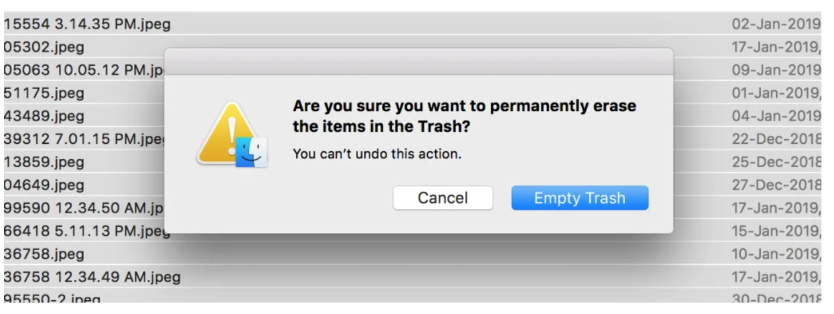
Example: User in Control

Slide 18
Place the User in Control
Allow the interaction to be customized as skill levels advance.
For example, use of shortcut keys
Hide technical internals from the casual user.
Example, GUI vs. command line
Design for direct interaction with objects that appear on the screen
Example: Can you suggest examples?

Slide 19
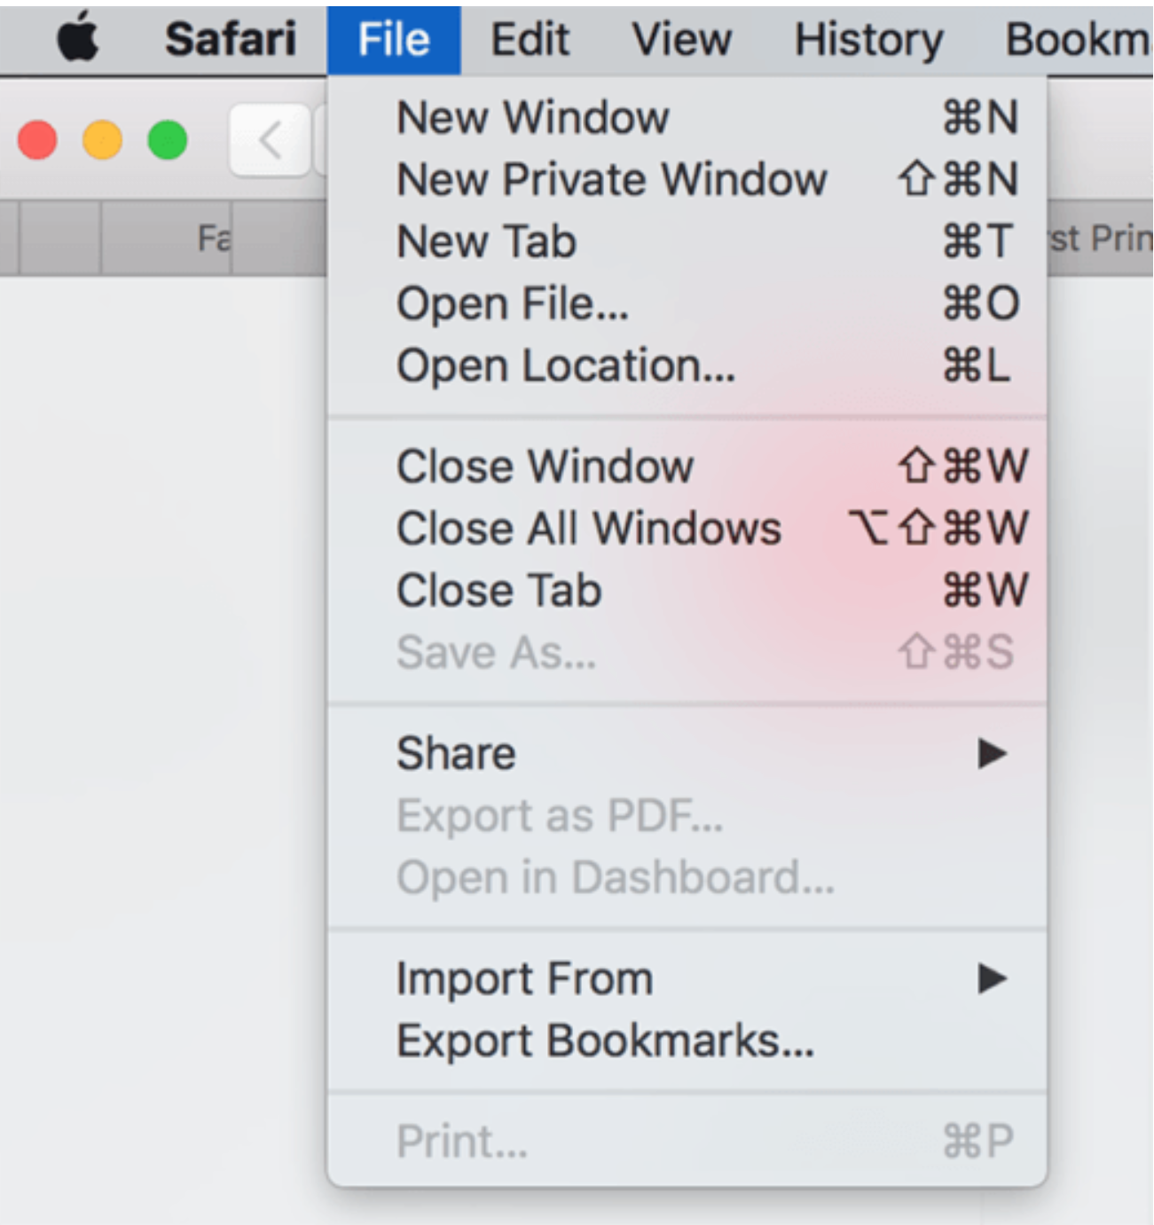
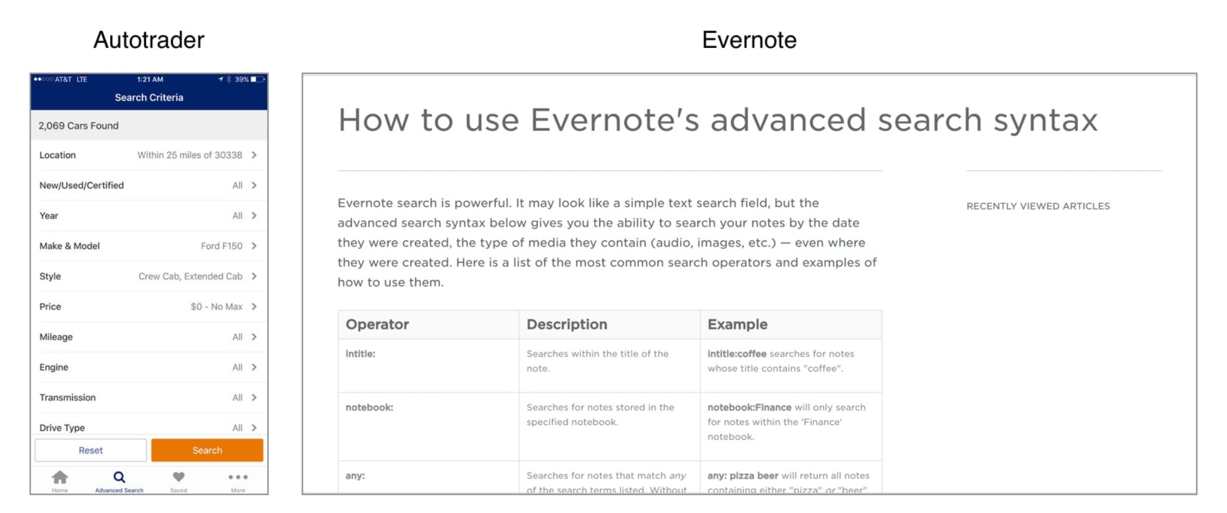
Example: User in Control

Slide 20
Reduce the User’s Memory Load
Reduce demand on short-term memory.
Establish meaningful defaults. Example: Today’s date
Define shortcuts that are intuitive. Example: Ctrl - S for Save
Visual layout based on a real-world metaphor (e.g., desktop)
Disclose information in a progressive fashion.
Example: Any examples? Every applied for a job?

Slide 21
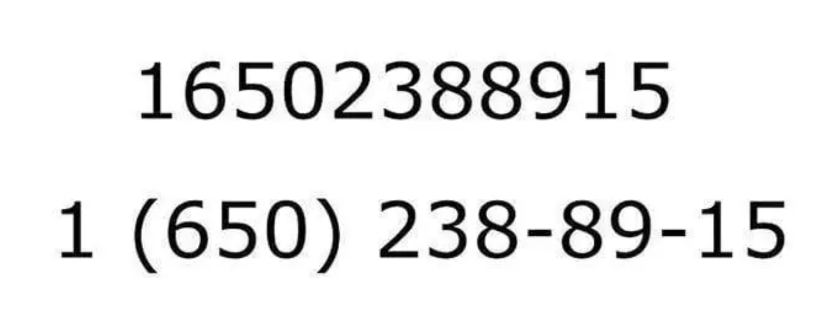

Example: Reduce User’s Memory Load

Slide 22
Make the Interface Consistent
Maintain consistency across a complete product line. Example: Word, Excel, PowerPoint, Access
Standard look and placement of user controls (e.g., hamburger button)
Use real world metaphors (e.g., shopping cart)
Do not make changes unless there is a good reason to do so.
Notes:
Allow the user to put the current task into a meaningful context

Slide 23
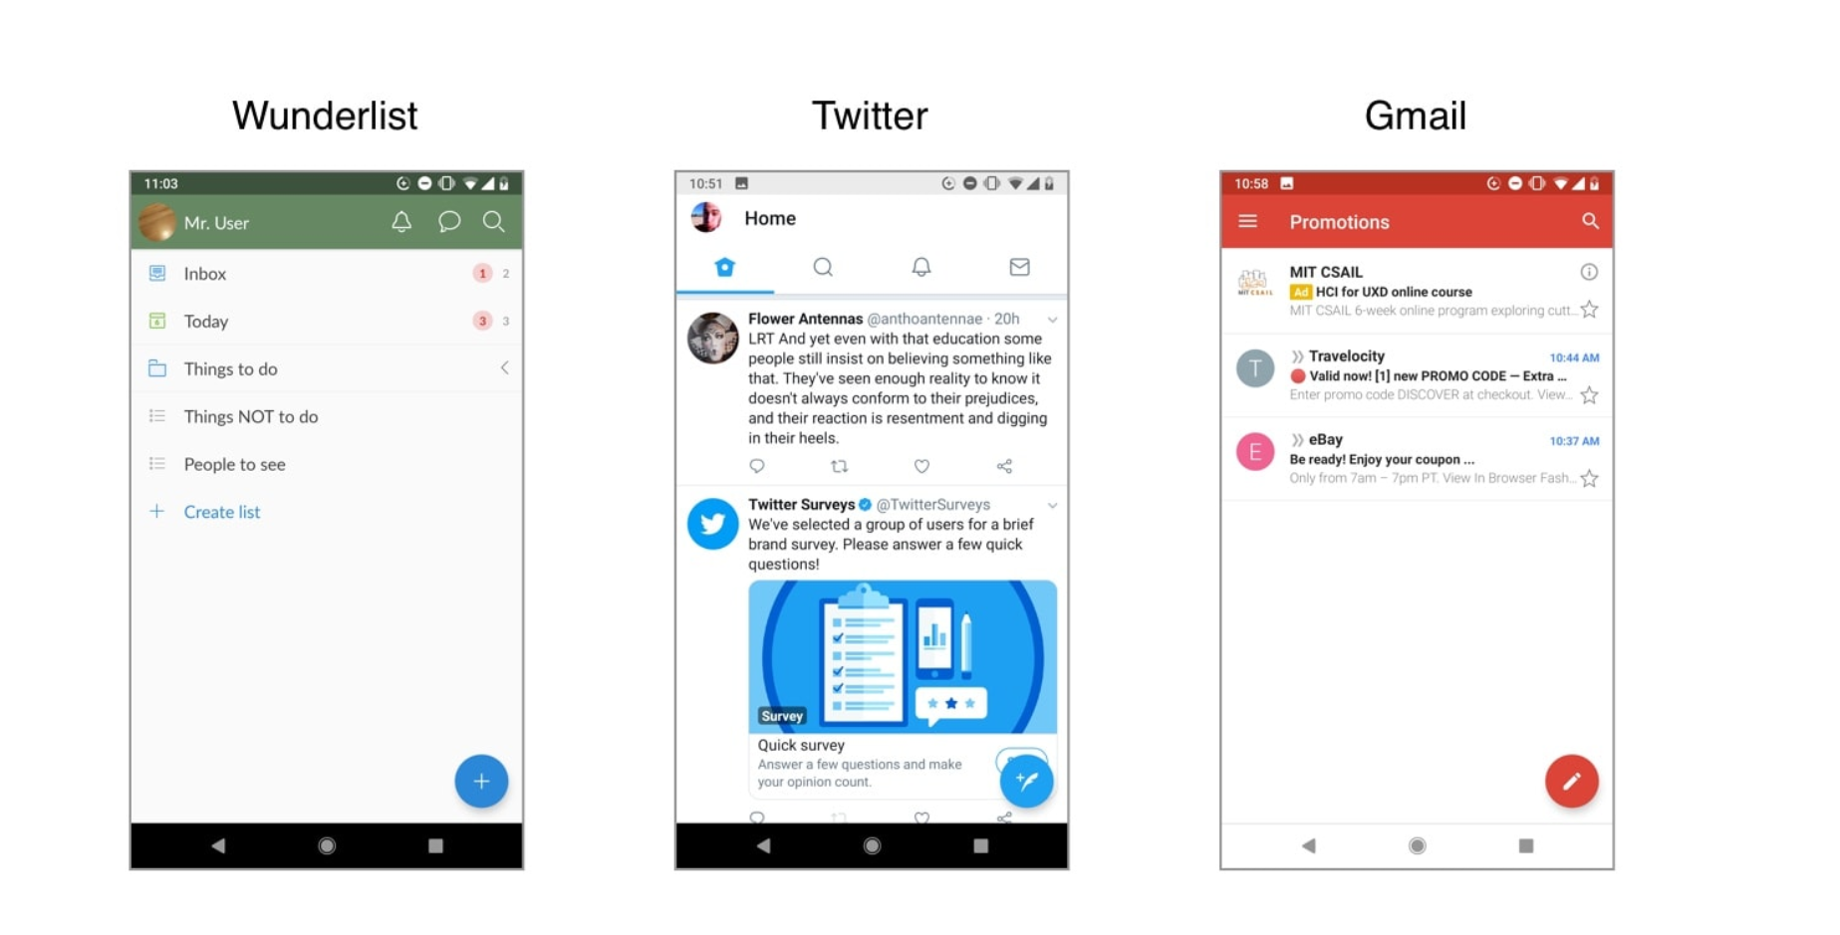
Example - Consistency
Floating Action Button

Slide 24
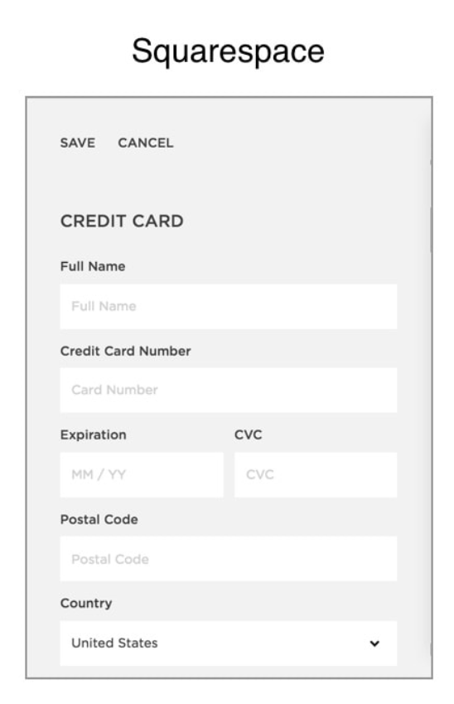
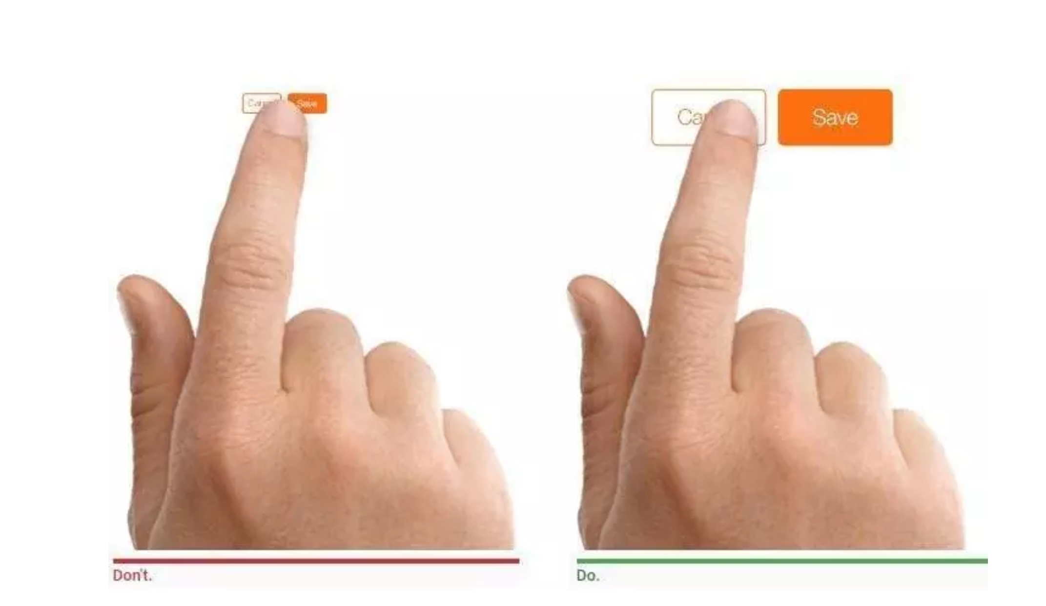
Make Your Interface Accessible
Provide necessary accommodations
Can a visually impaired person use these interfaces?
Notes:
One great example of how accessible design helps everyone is placing labels outside text entry fields instead of inside them. This lets screen readers read them for visually impaired users, while it reminds all users what information goes in each text field. Similarly, using a high contrast between text and background colors helps both users with visual impairments and users in low-light settings read text on the screen.

Slide 25
References
Pressman, Software Engineering: A Practitioner's Approach, 9e, copyright 2020
Crash Course in UX design https://www.youtube.com/watch?v=_lyzy-vChh4
Golden Rules https://xd.adobe.com/ideas/process/ui-design/4-golden-rules-ui-design/
The 5 Key UX Design Principles You Need To Know https://careerfoundry.com/en/blog/ux-design/5-key-principles-for-new-ux-designers/
16 Important UX Design Principles for Newcomers https://www.springboard.com/blog/ux-design-principles/
How to Wireframe https://www.youtube.com/watch?v=PmmQjLqJQlY
Accessibility Principles https://www.w3.org/WAI/fundamentals/
https://uxplanet.org/wireframe-mockup-prototype-what-is-what-8cf2966e5a8b

